Slide 1
text & audio based simple ‘choose your own’- game for kids
JUNGLE ADVENTURE

Slide 2

Introduction
01
2
Choose your own.
2 ways Adventurous Game.
Absolutely made for kids.
Luck + Ethics.
Have points.

Slide 3
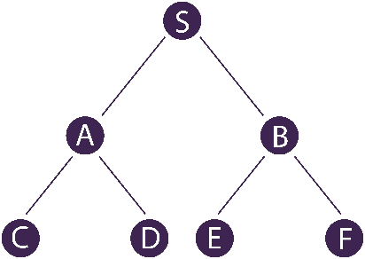


Working procedure
02
2
Binary Tree.
2 main Stories with 11 possible ways.
Implement Basic Python codes.
Added Audio to give it some life.

Slide 4
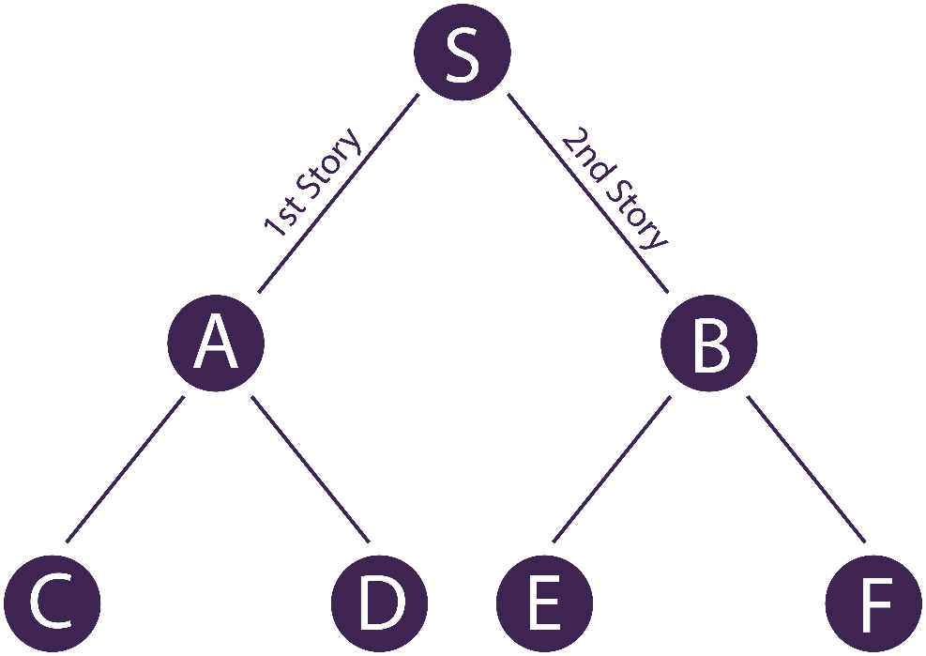
03
2
Internal Structure
On each Node:
A story line.
Points.
New Choice.

Slide 5
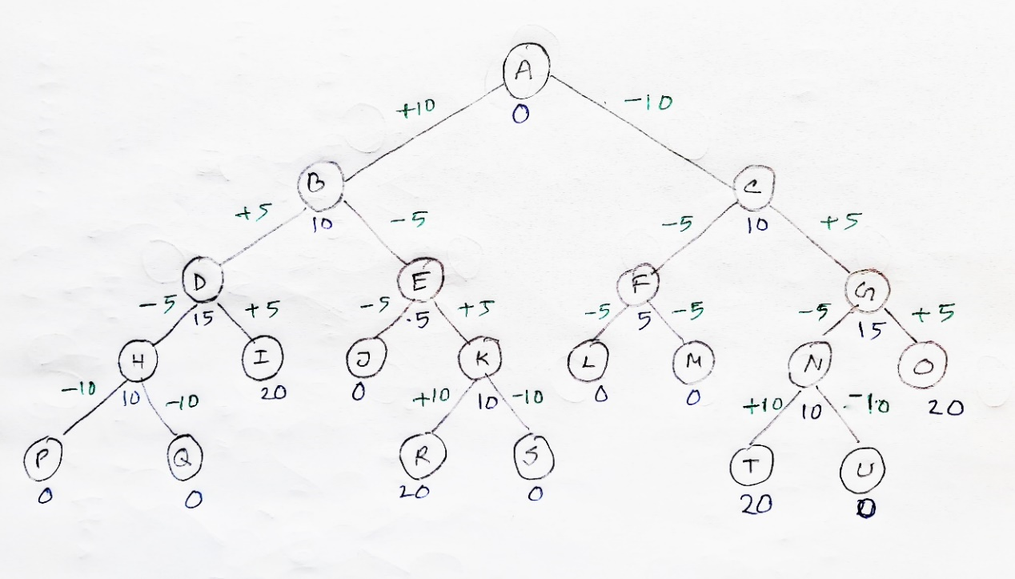
Our main Tree
04
2
4 Levels
11 Total Paths.
4 Wining Paths.
7 Losing Paths.

Slide 6

How to Play?
05
2
Output - Audio
Input - Text

Slide 7

Future Work
06
2
Add Graphical view
Make Animated
Work on py game / Python GUI

Slide 8
Thank You
ANY QUESTIONS?

